Slide 1

The solution x by the iterative methods(Jacobi Method &Gauss-Seidel method) using C++ programming and Compare the number of iterations taken to find x through the above methods done by Anupam Sen & Nilay Sarkar (Roll-MA20MSCST11004 & MA20MSCST11019) Under the supervision of Dr. Balasubramaniam Jayaram (Professor) DEPARTMENT OF MATHEMATICS Indian Institute of Technology Hyderabad June, 2021

Slide 2
JACOBI METHOD

Slide 3
BASIC IDEA ON JACOB METHOD
The Jacobi method is the simplest iterative method for solving a (square) linear system Ax = b.
Where,
a₁₁ a₁₂ a₁₃ …a_{1𝑛} 𝑥₁ b₁ A= a₂₁ a₂₂ a₂₃ …a_{2𝑛} x= 𝑥₂ b= b₂ ⋮ ⋮ ⋮
a_{𝑛1} a_{𝑛2} a_{𝑛3} …a_{𝑛𝑛}
Now we are solving Ax=b & we get,
a₁₁𝑥₁ + a₁₂𝑥₂ + ⋯ + a_{1𝑛}𝑥_{𝑛} = b₁
a₂₁𝑥₁ + a₂₂𝑥₂ + ⋯ + a_{2𝑛}𝑥_{𝑛} = b₂
⋮
a_{𝑛1} 𝑥₁+ a_{𝑛2}𝑥₂ + ⋯ + a_{𝑛𝑛}𝑥_{𝑛} = b_{𝑛}
𝑥_{𝑛}
b_{𝑛}

Slide 4
BASIC IDEA ON JACOB METHOD
If satisfies the diagonal dominance property, that is..
i) |a₁₁|> |a₁₂|+|a₁₃|+ ⋯ +|a_{1𝑛}|
ii) |a₂₂|> |a₂₁|+|a₂₃|+ ⋯ +|a_{2𝑛}|
⋮
iii) |a_{𝑛𝑛} |> |a_{𝑛1}|+|a_{𝑛2}|+ ⋯ +|a_{𝑛𝑛-1} |
Then we can use Jacobi’s method for given system of equation(Ax=b).

Slide 5
Two assumptions made on Jacobi Method:
1. The system given by,
a₁₁𝑥₁ + a₁₂𝑥₂ + ⋯ + a_{1𝑛}𝑥_{𝑛} = b₁
a₂₁𝑥₁ + a₂₂𝑥₂ + ⋯ + a_{2𝑛}𝑥_{𝑛} = b₂
⋮
a_{𝑛1} 𝑥₁+ a_{𝑛2}𝑥₂ + ⋯ + a_{𝑛𝑛}𝑥_{𝑛} = b_{𝑛}
Has a unique solution.
2. The coefficient matrix 𝐴 has no zeros on its main diagonal, that is a₁₁, a₂₂, a_{33.},....,a_{𝑛𝑛} are non zeros.

Slide 6

Main idea of Jacobi method
To begin, solve the 1st equation for 𝑥₁, the 2nd equation for 𝑥₂ and 3rd equation
for 𝑥₃ and so on to obtain the rewritten equations:
$\text{x}\text{1}=\frac{1}{\text{a}\text{11}}(\text{b}\text{1}−\text{a}\text{12}\text{x}\text{2}−\text{a}\text{13}\text{x}\text{3}−\text{⋯ }\text{a}\text{1}\text{n}\text{x}\text{n})$
$\text{x}\text{2}=\frac{1}{\text{a}\text{22}}(\text{b}\text{2}−\text{a}\text{2}\text{1}\text{x}\text{1}−\text{a}\text{23}\text{x}\text{3}−\text{⋯} \text{a}\text{2}\text{n}\text{x}\text{n})$
⋮
$\text{x}\text{n}=\frac{1}{\text{a}\text{nn}}$ $(\text{b}\text{n}−$ $\text{a}\text{n}\text{1}\text{x}\text{1}$ $−$ $\text{a}\text{n}\text{2}\text{x}\text{2}− \text{⋯} \text{a}\text{n}\text{,}\text{n}\text{−1}\text{x}\text{n}\text{−1}$)

Slide 7
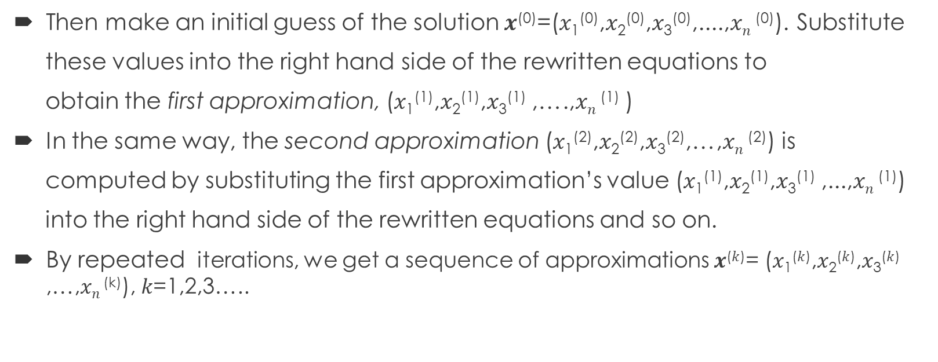
Main idea of Jacobi method
Then make an initial guess of the solution 𝒙⁽⁰⁾=(𝑥₁⁽⁰⁾,𝑥₂⁽⁰⁾,𝑥₃⁽⁰⁾,....,𝑥$\text{n}$⁽⁰⁾). Substitute
these values into the right hand side of the rewritten equations to
obtain the first approximation, (𝑥₁⁽¹⁾,𝑥₂⁽¹⁾,𝑥₃⁽¹⁾ ,….,𝑥$\text{n}$⁽¹⁾ )
In the same way, the second approximation (𝑥₁⁽²⁾,𝑥₂⁽²⁾,𝑥₃⁽²⁾,…,𝑥$\text{n}$⁽²⁾) is
computed by substituting the first approximation’s value (𝑥₁⁽¹⁾,𝑥₂⁽¹⁾,𝑥₃⁽¹⁾ ,...,𝑥$\text{n}$⁽¹⁾)
into the right hand side of the rewritten equations and so on.
By repeated iterations, we get a sequence of approximations 𝒙^{(𝑘)}= (𝑥₁^{(𝑘)},𝑥₂^{(𝑘)},𝑥₃^{(𝑘)} ,…,𝑥$\text{n}$^{(k)}), 𝑘=1,2,3…..

Slide 8

EXAMPLE OF JACOBI METHOD
Apply the Jacobi method to solve,
12𝑥₁ + 3𝑥₂ - 5𝑥₃ = 1
𝑥₁+ 5𝑥₂ + 3𝑥₃=28
3𝑥₁ + 7𝑥₂ + 13𝑥₃ = 76
Now we get,
$$\text{x}\text{1}=\frac{1}{\text{1}\text{2}}(\text{1}−\text{3}\text{x}\text{2}+\text{5}\text{x}\text{3})$$
$$\text{x}\text{2}=\frac{1}{\text{5}}(\text{2}\text{8}−\text{x}\text{1}−\text{3}\text{x}\text{3})$$
$$\text{x}\text{3}=\frac{1}{13}(\text{7}6−\text{3}\text{x}\text{1}−\text{7}\text{x}\text{2})$$
We will take initial value $\text{x}\text{1}$⁽⁰⁾ = 0, $\text{x}\text{2}$⁽⁰⁾ = 0, $\text{x}\text{3}$⁽⁰⁾ = 0.

Slide 9
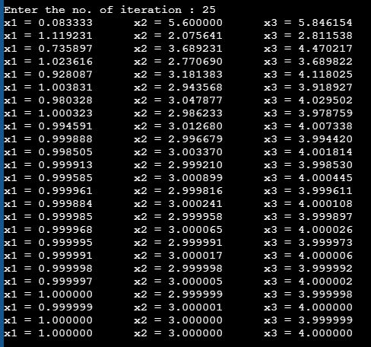
Result of Jacobi method
Here I attach the 25 iterative values.
So I got the final value in 25th approximation.
So the final value of 𝑥₁= 1.0000, 𝑥₂=3.0000 & 𝑥₃= 4.0000

Slide 10
GAUSS-SEIDEL METHOD

Slide 11
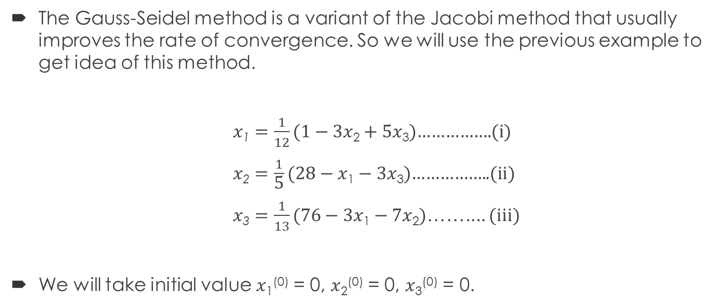
Main idea of Gauss-Seidel method
The Gauss-Seidel method is a variant of the Jacobi method that usually improves the rate of convergence. So we will use the previous example to get idea of this method.
$\text{x}\text{1}=\frac{1}{12}(\text{1}−\text{3}\text{x}\text{2}+\text{5}\text{x}\text{3})$…………….(i)
$\text{x}\text{2}=\frac{1}{\text{5}}(\text{2}8−\text{x}\text{1}−\text{3}\text{x}\text{3})$……………..(ii)
$\text{x}\text{3}=\frac{1}{13}(\text{7}6−\text{3}\text{x}\text{1}−\text{7}\text{x}\text{2})$…….... (iii)
We will take initial value $\text{x}\text{1}$⁽⁰⁾ = 0, $\text{x}\text{2}$⁽⁰⁾ = 0, $\text{x}\text{3}$⁽⁰⁾ = 0.

Slide 12
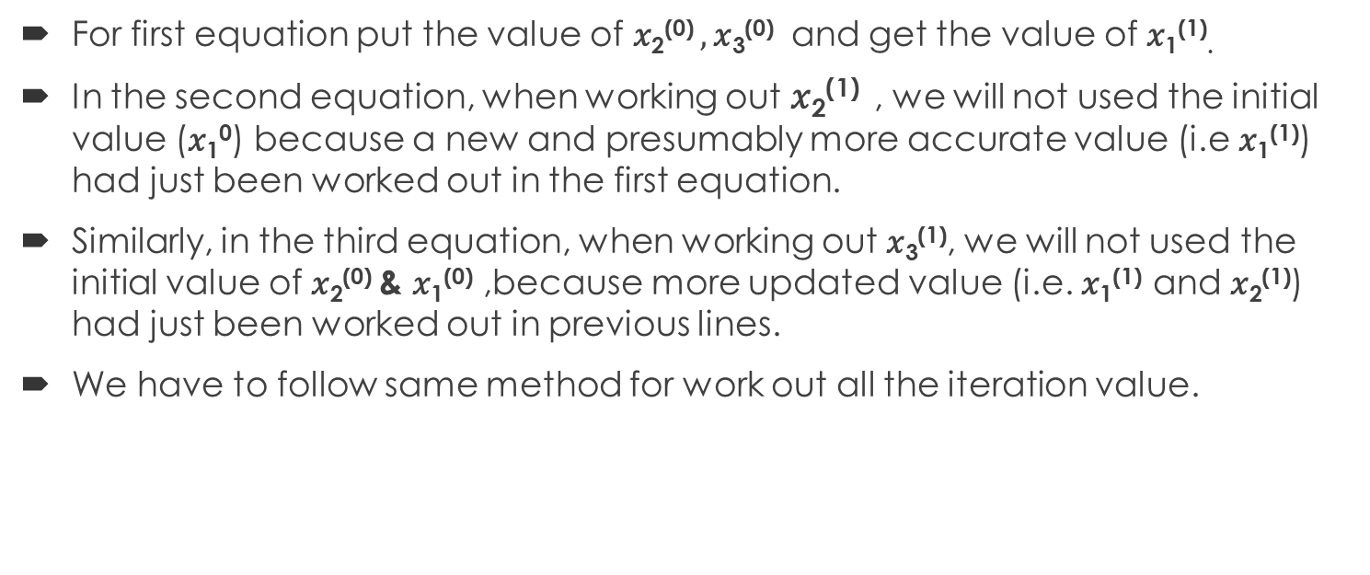
Calculation for First Iteration
For first equation put the value of $\text{x}\text{2}$⁽⁰⁾ $, \text{x}\text{3}$⁽⁰⁾ and get the value of $\text{x}\text{1}$⁽¹⁾$\text{.}$
In the second equation, when working out $\text{x}\text{2}$⁽¹⁾ , we will not used the initial value ($\text{x}\text{1}$⁰) because a new and presumably more accurate value (i.e $\text{x}\text{1}$⁽¹⁾) had just been worked out in the first equation.
Similarly, in the third equation, when working out$\text{x}\text{3}$⁽¹⁾, we will not used the initial value of $\text{x}\text{2}$⁽⁰⁾ & $\text{x}\text{1}$⁽⁰⁾ ,because more updated value (i.e. $\text{x}\text{1}$⁽¹⁾ and $\text{x}\text{2}$⁽¹⁾) had just been worked out in previous lines.
We have to follow same method for work out all the iteration value.

Slide 13
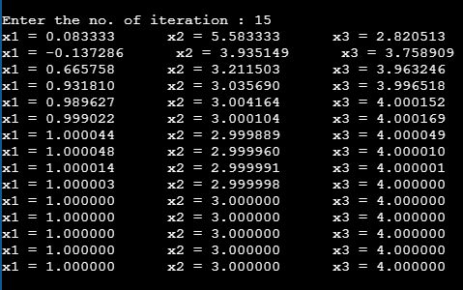
Idea on Gauss-Seidel Method
The Gauss-Seidel method implements the strategy of always using the latest available value of a particular variable. To clarify the operation of the Gauss-Seidel method, we will go through the first few iterations of the example.
RESULT :- So I get the final value in 11th approximation.

Slide 14
Compare of this two method
After doing the calculation with the same example, I saw that the Gauss-Seidel method took only 11 iterations but the Jacobi method took 25 iterations to get the final value.
Therefore, it is possible to achieve convergence faster in case of Gauss-Seidel method than Jacobi method.

Slide 15
THANK YOU

